Slide 1
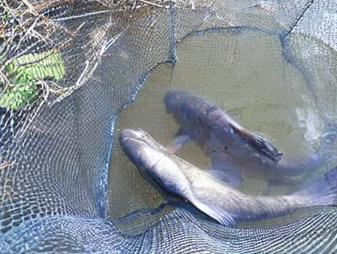
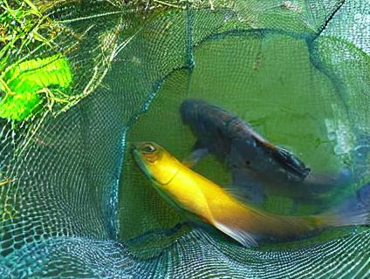
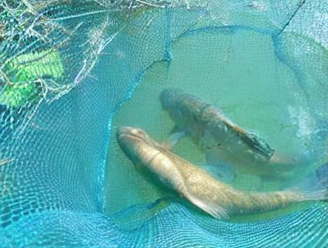
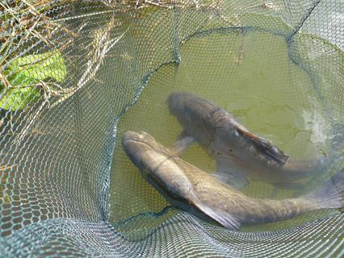



generated images
image
InstructPix2Pix
Turn the tench into a silver beauty.
tench
Turn the tench into a glowing fish.
answer
Turn the tench into a strong swimmer.
label
Meta-Llama-3.1-8B-Instruct
prompts
Generate 70 different phrases of no more than 7 words to describe the label ‘{label_text}’. Each phrase should follow the format 'Turn the {label_text} [adjective],' where [adjective] is a adjective descriptive word that is highly aligned with the label and visually distinct.
guidance prompt words

Slide 2
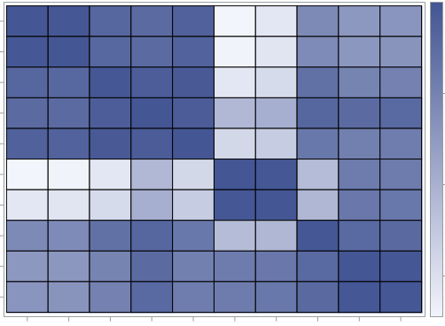
Turn the tench into a silver beauty.
Turn the tench into a glowing fish.
Turn the tench into a strong swimmer.
tench
CLIP
Text
Encoder
CLIP Image Encoder
generated images
select the top N
based on the sorted sum of
the calculated scores
image

Slide 3
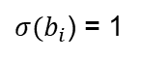
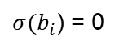
抽检
已检测
次品
合格品
次品
合格品
$σ(b_{i}$) = 0
抽检
次品
合格品
未检测
$σ(b_{i}$) = 1

Slide 4
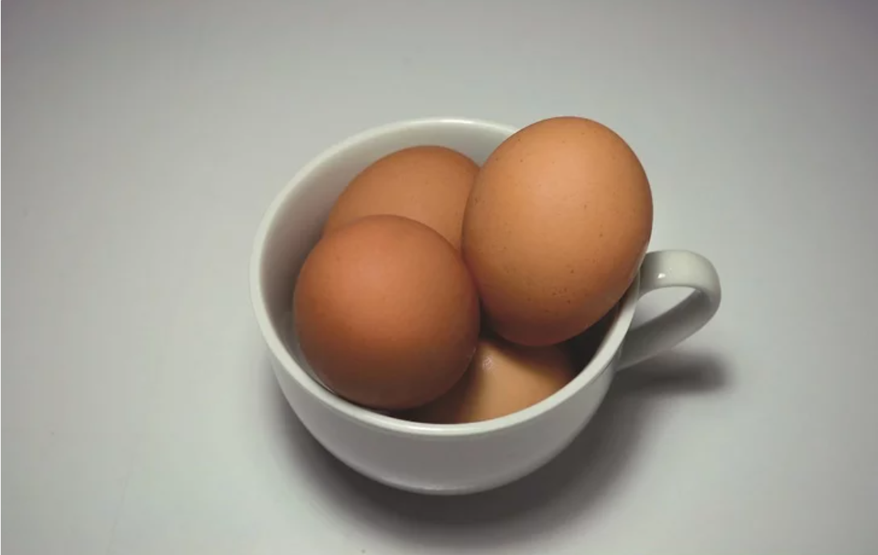
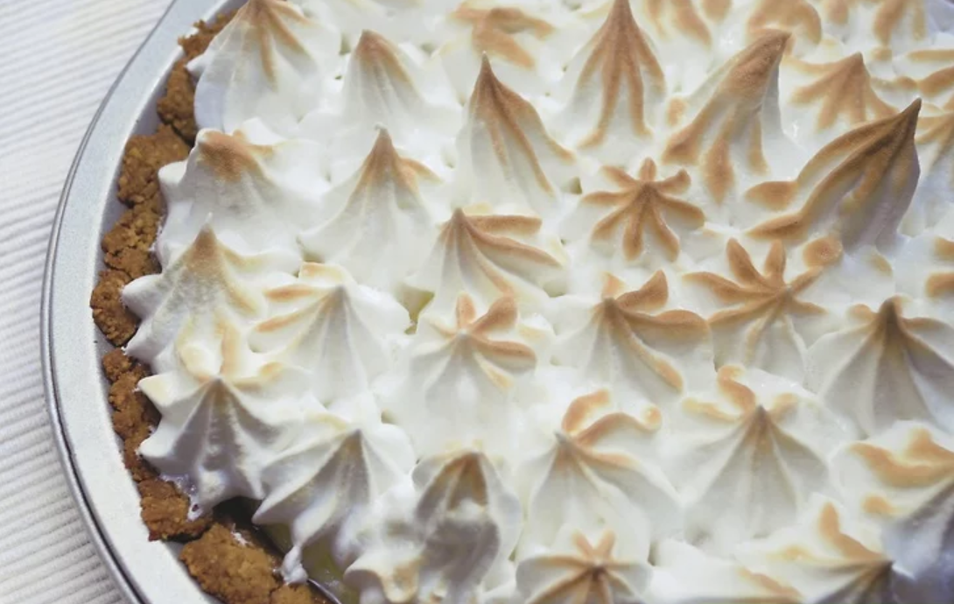

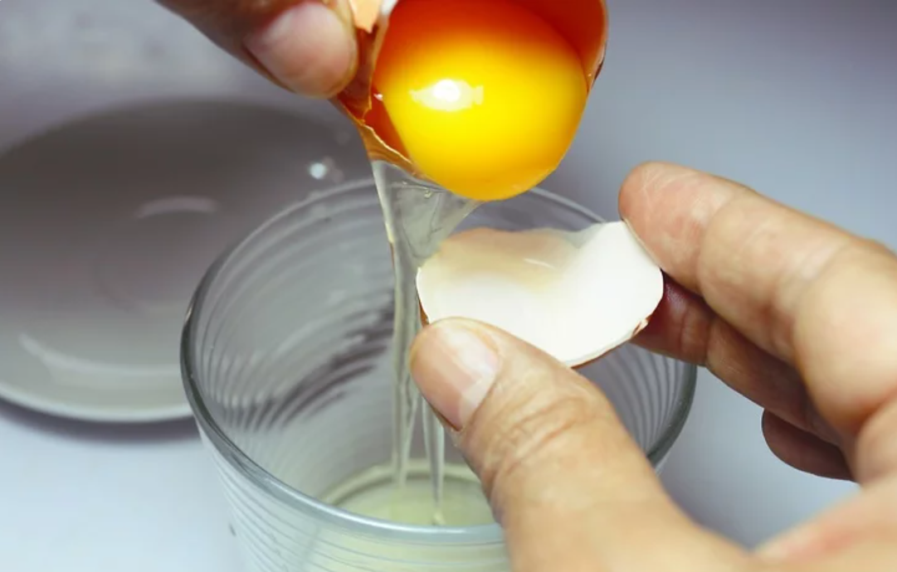
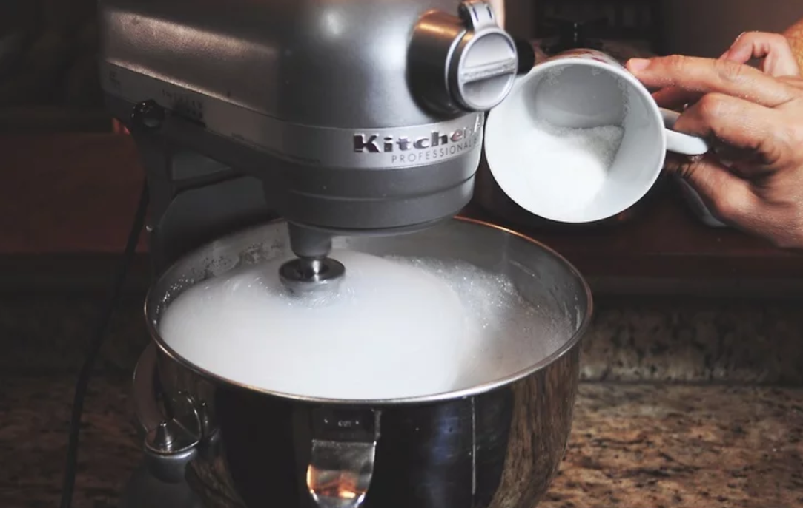
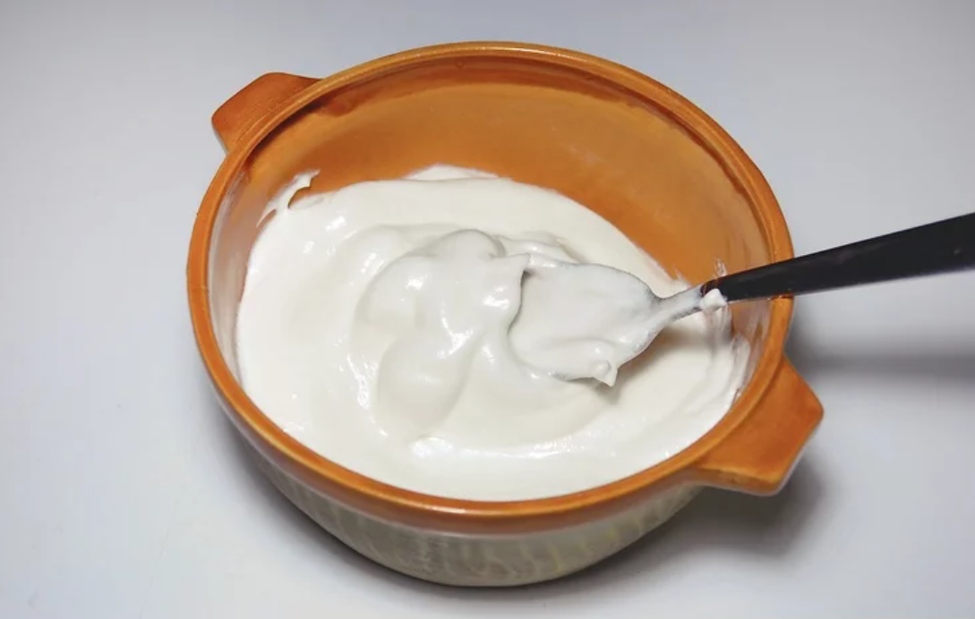
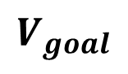
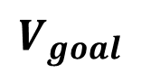
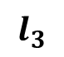
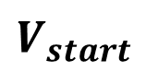
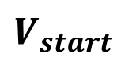
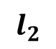
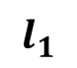
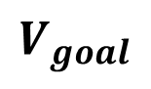
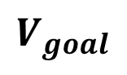
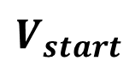
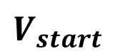
Seen Observation
Intermediate Supervision
Predicted Action
Cross-Attention
pour
egg
add
sugar
whisk
mixture
pour
egg
add
sugar
whisk
mixture
put meringue
into oven
$$V_{start}$$
$$l_{1}$$
$$l_{2}$$
$$l_{3}$$
$$V_{goal}$$
(a) Supervised by language instructions
pour
egg
add
sugar
whisk
mixture
put meringue
into oven
Task: Make Meringue
$$V_{start}$$
$$V_{goal}$$
(b) Supervised by task class
pour
egg
add
sugar
whisk
mixture
put meringue
into oven
$$V_{start}$$
$$V_{goal}$$
LLM
LLM
LLM
LLM
before
state
after
state
before
state
after
state
before
state
after
state
before
state
after
state
(c) Supervised by LLM’s descriptions
CA
CA
CA
pour
egg
add
sugar
whisk
mixture
put meringue
into oven
$$V_{start}$$
$$V_{goal}$$
interpolate
interpolate
……
……
(d) Supervised by task class and visual observations obtained by interpolation

Slide 5
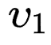
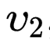
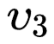
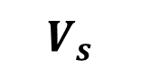
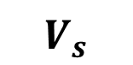
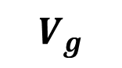
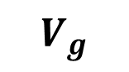
Seen Observation
Intermediate Supervision
Predicted Action
pour
egg
add
sugar
whisk
mixture
put meringue
into oven
$$V_{s}$$
$$V_{g}$$
condition supervision
Preprocess Model
(a) Supervised by condition supervision
pour
egg
add
sugar
whisk
mixture
put meringue
into oven
$$V_{s}$$
$$V_{g}$$
interpolated latent features supervision
Latent Space Temporal Logical Interpolation Module
(b) Supervised by especially visual observations obtained by interpolation
(a) Supervised by condition supervision obtained from various preprocessing methods

Slide 6
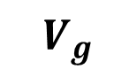
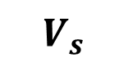
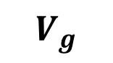
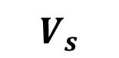
Seen Observation
Supervision Scope
Predicted Action
Latent Feature
pour
egg
add
sugar
whisk
mixture
put meringue
into oven
$$V_{s}$$
event, task class, graph, language instructions…
$$V_{g}$$
Text-Level Supervision
(a) Supervised by condition supervision obtained from various preprocessing methods
pour
egg
add
sugar
whisk
mixture
put meringue
into oven
$$V_{s}$$
$$V_{g}$$
interpolate
interpolate
(b) Supervised by latent visual features obtained by interpolation

Slide 7
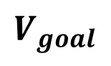
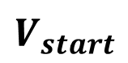
Seen Observation
Intermediate Supervision
Predicted Action
Cross-Attention
CA
CA
CA
pour
egg
add
sugar
whisk
mixture
put meringue
into oven
$$V_{start}$$
$$V_{goal}$$
interpolate
interpolate
……
……
Supervised by task class and visual observations obtained by interpolation

Slide 8
Seen Observation
Supervision Scope
Predicted Action
Latent Feature
pour
egg
add
sugar
whisk
mixture
put meringue
into oven
$$V_{s}$$
event, task class, graph, language instructions…
$$V_{g}$$
Text-Level Supervision
(a) Supervised by condition supervision obtained from various preprocessing methods
pour
egg
add
sugar
whisk
mixture
put meringue
into oven
Bidirectional Promotion
$$V_{s}$$
$$V_{g}$$
interpolate
interpolate
(b) Supervised by latent visual features obtained by interpolation

Slide 9
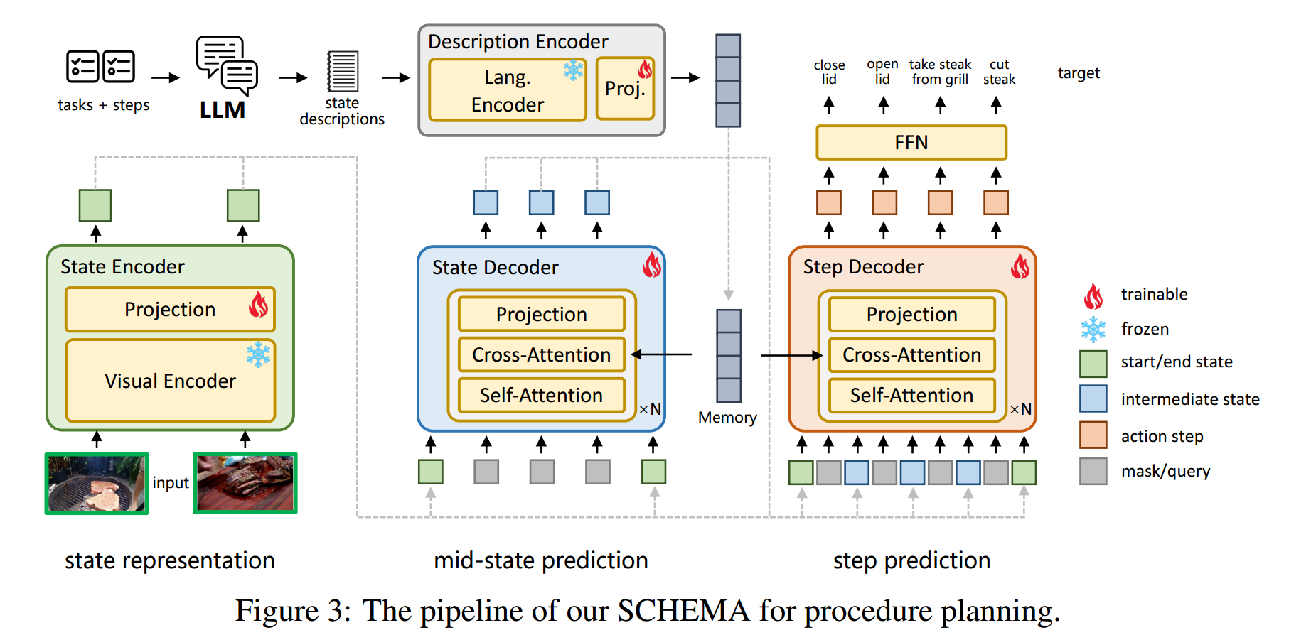
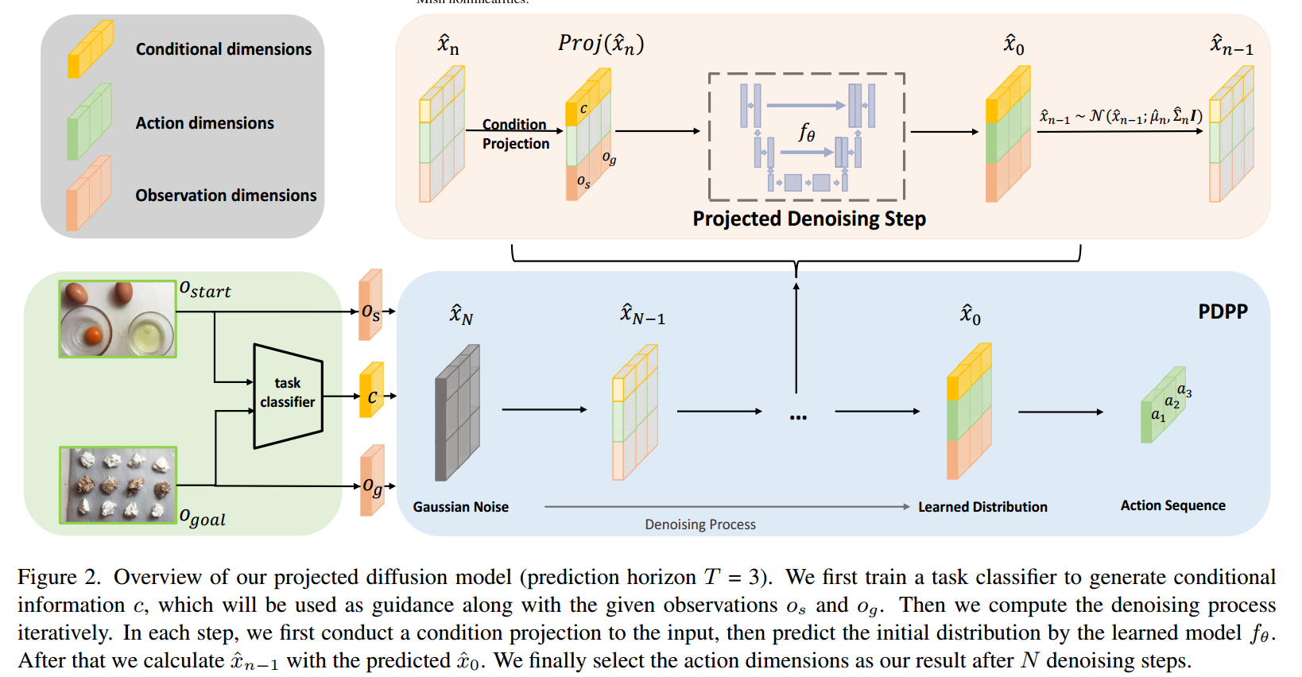
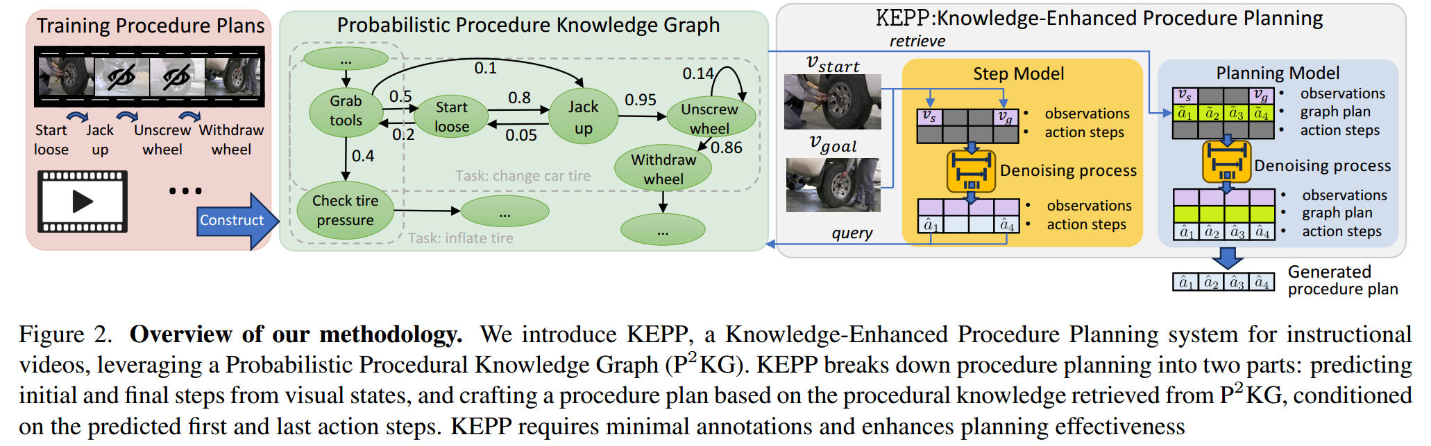
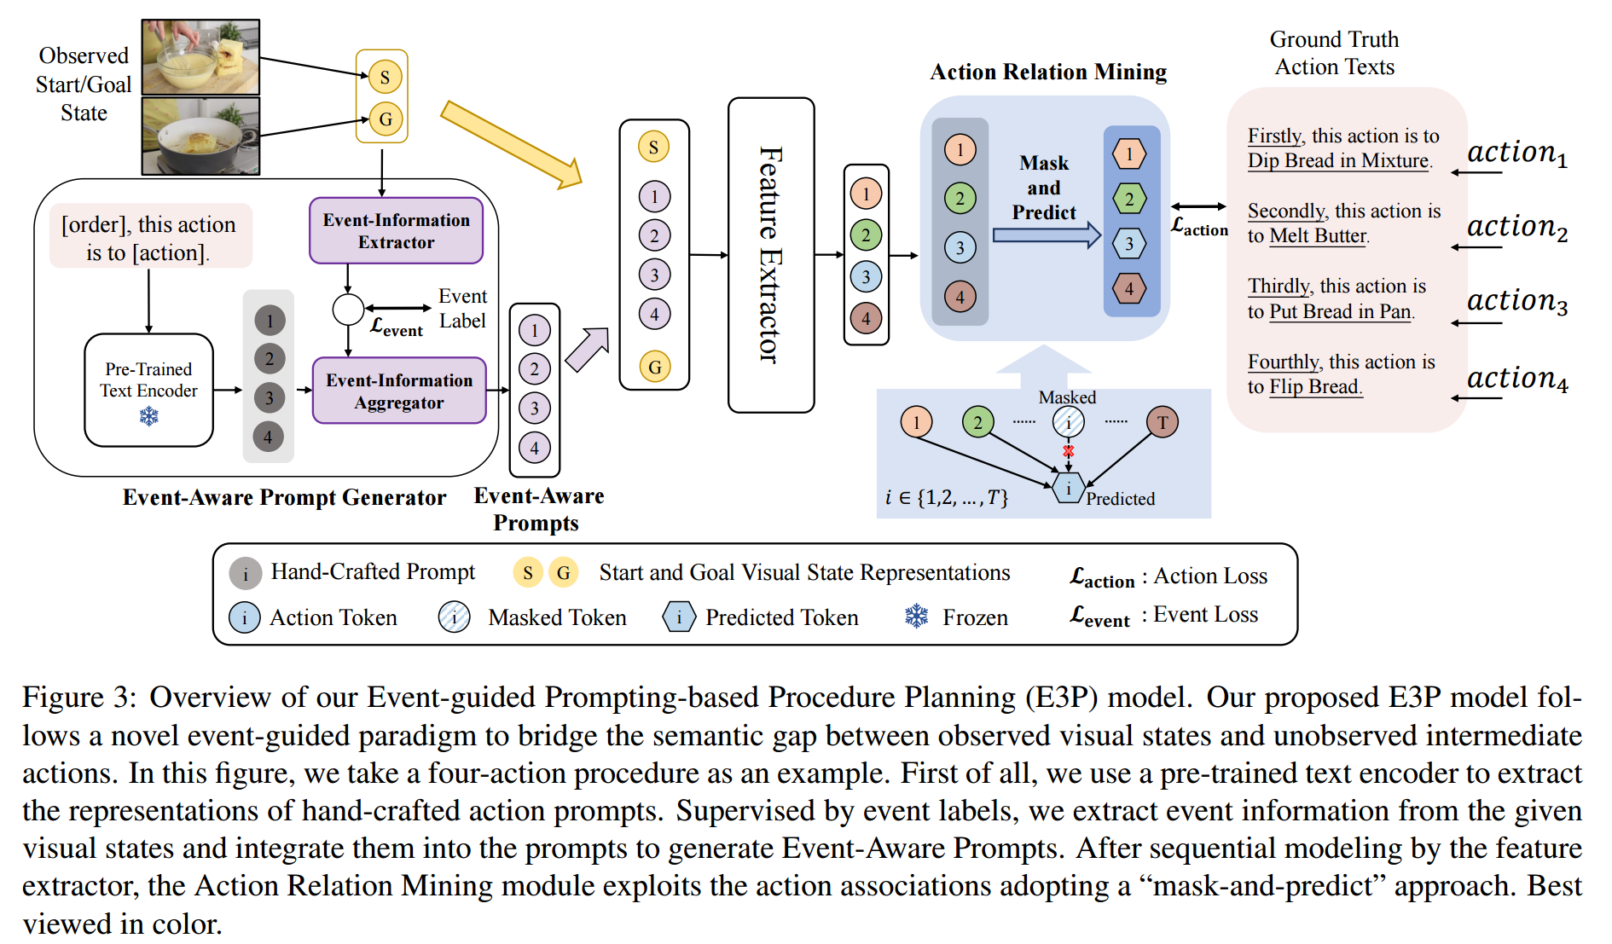
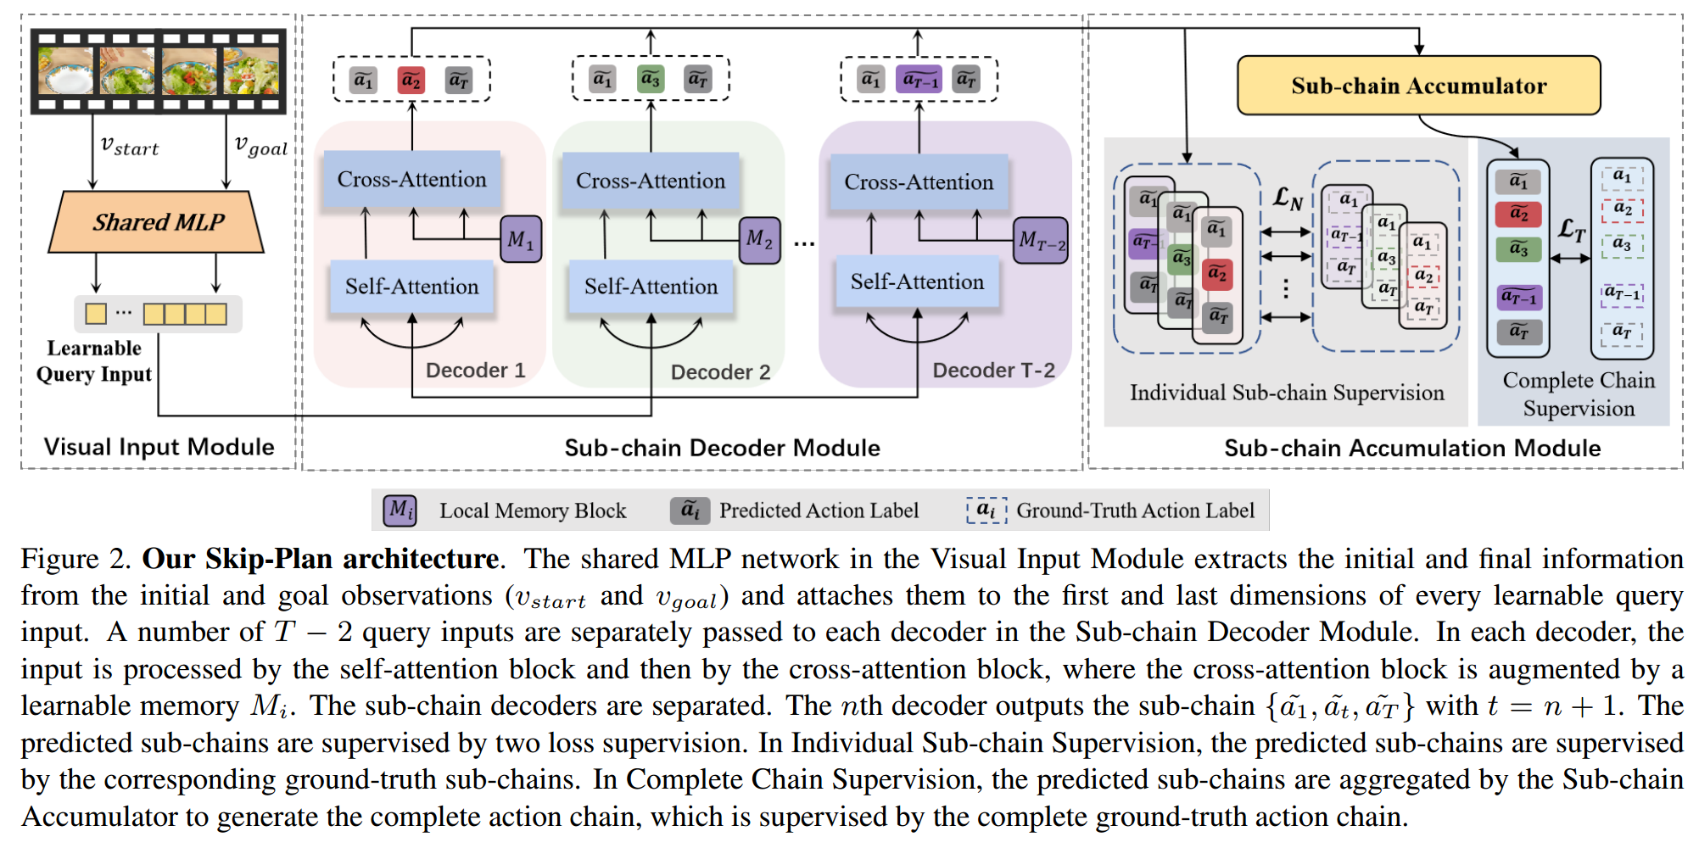

Slide 10
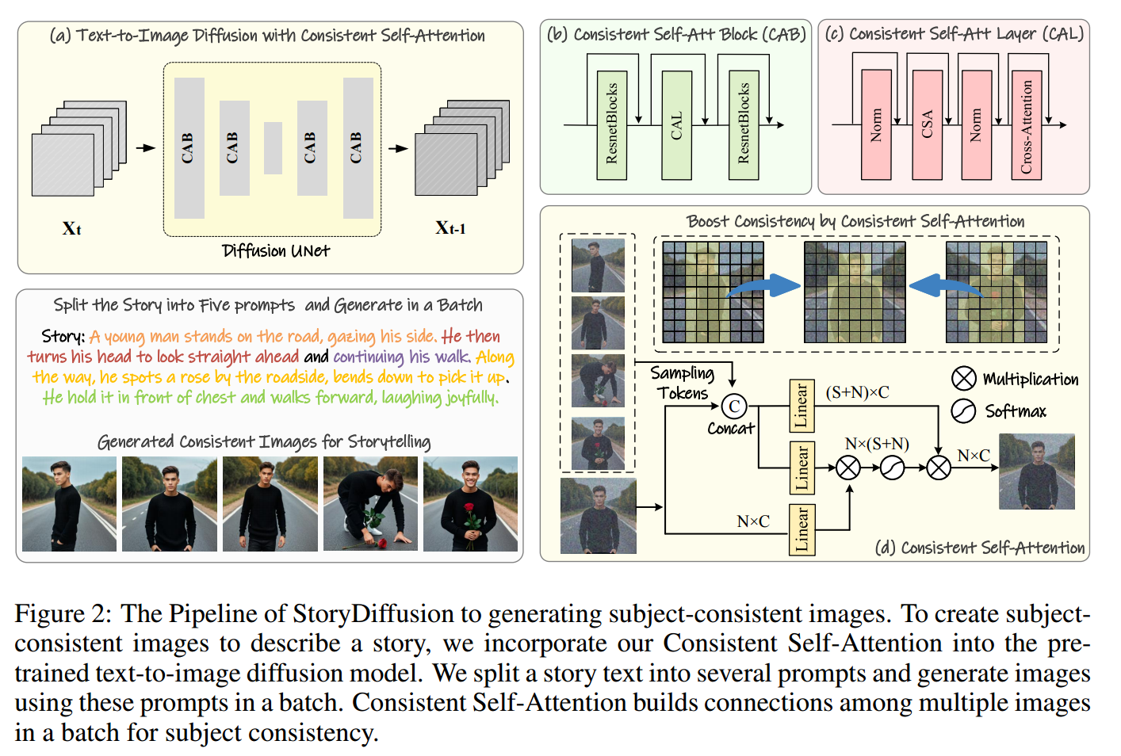
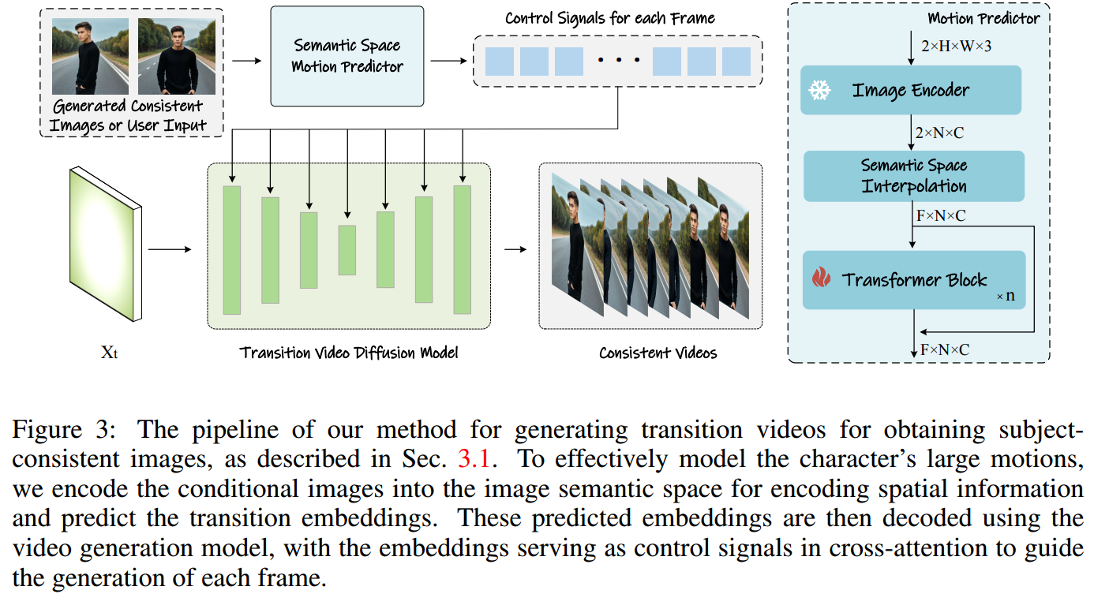
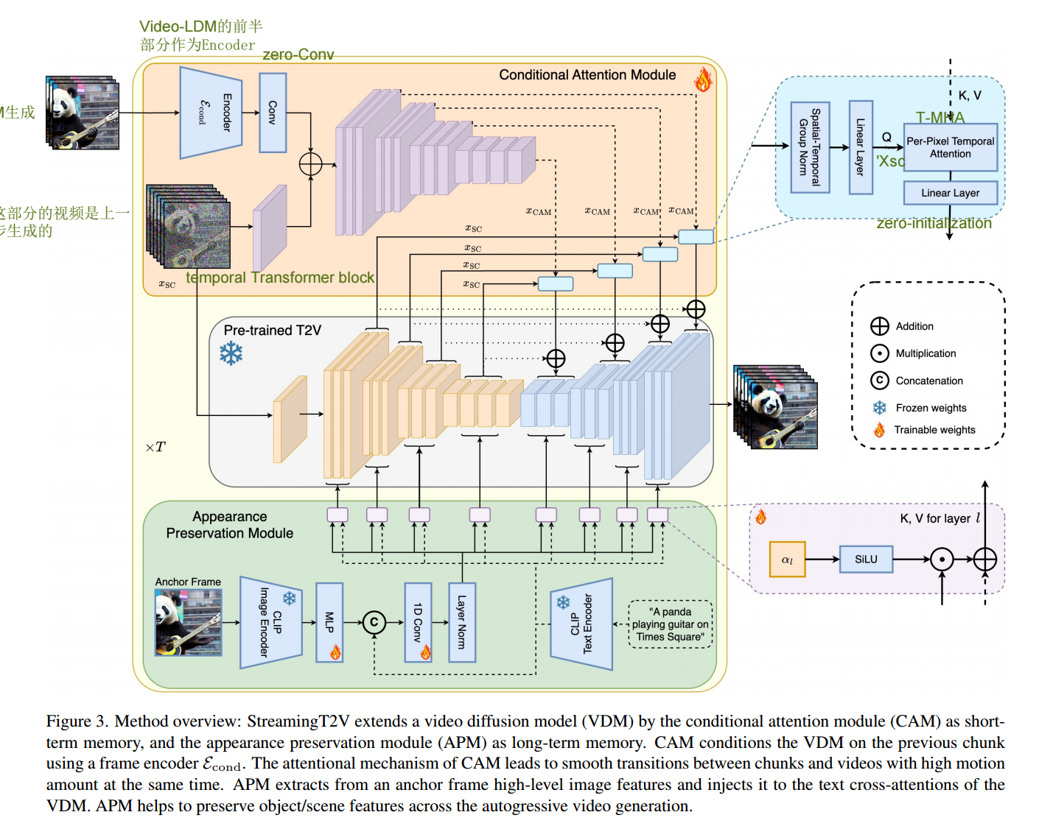

Slide 11
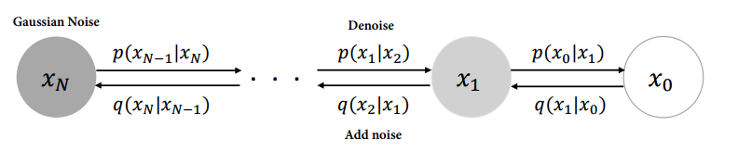
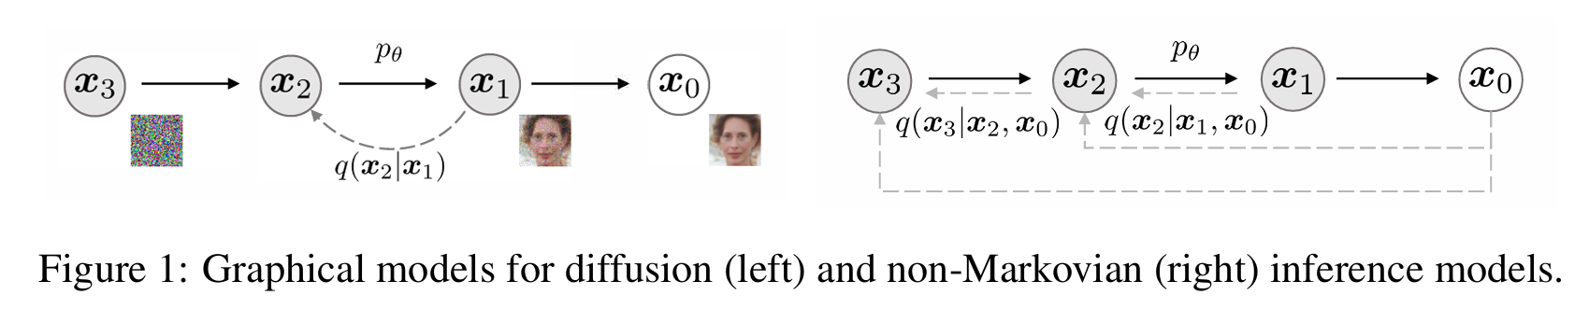

Slide 12
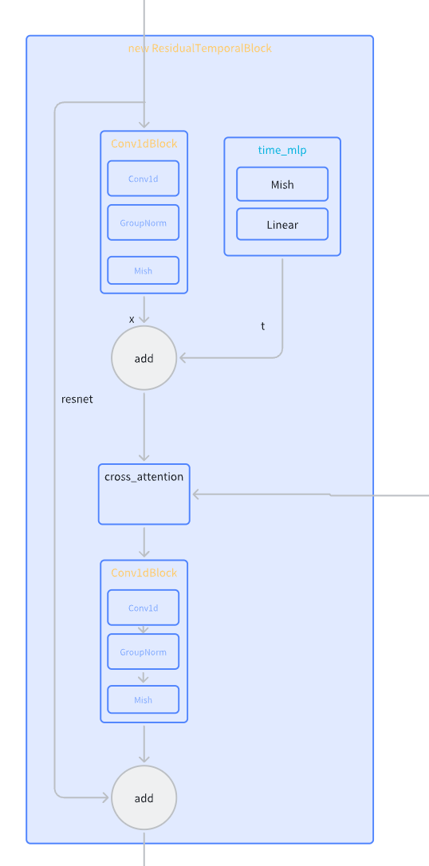
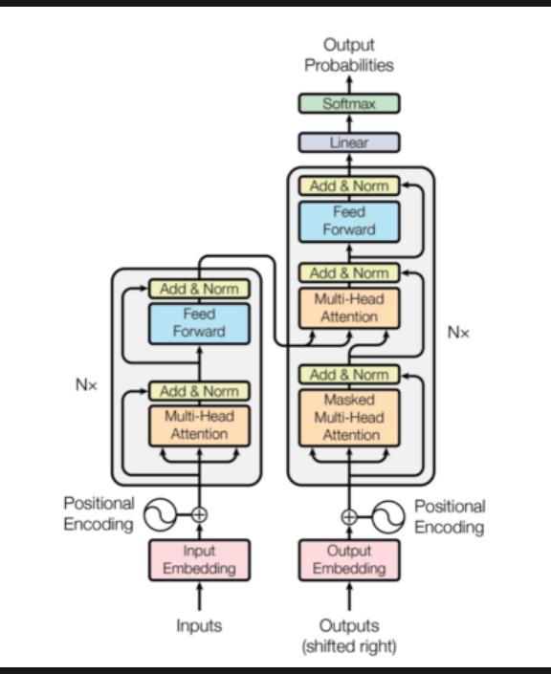
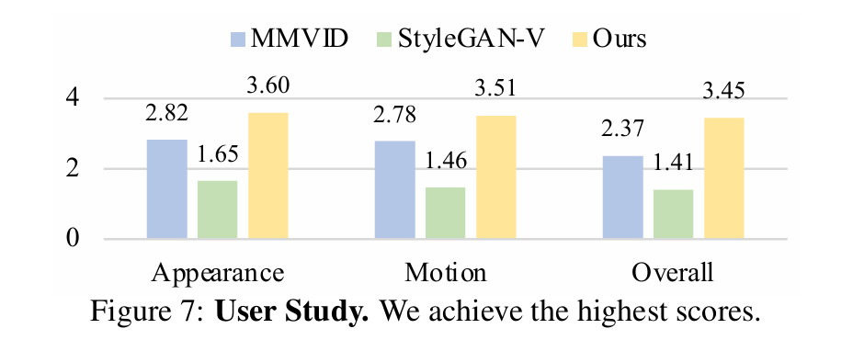
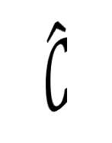







































Latent Space Temporal Interpolation Module
Observation Encoder (E）
Latent Space Interpolator
Transformer Encoder Blocks （TF）
1D convolution
ReLU
1D convolution
ReLU
Positional Encoding
$$V_{s}$$
$$L_{s}$$
•
Multi-Head
Attention
Add&Norm
Add&Norm
Feed
Forward
$$∅$$
$$F_{j}$$
$$I_{j}$$
Sigmoid
Linear
Initialization
1-$∅$
$$V_{g}$$
•
$$L_{g}$$
×N
Task Supervision
Interpolated Latent Features Supervision
Addition
extract
$$V_{s}$$
Latent Space
Temporal Interpolation
Module
· · ·
start frame
c
•
Residual Temporal Block
Multiplication
extract
$$V_{g}$$
TimeMLP
Transformer
Task
Classifier
$$\text{end} \text{frame}$$
Linear
$$F_{j}$$
Cross Attention
c
t
Concatenation
Mish
Linear
Conv1dBlock
Masked
Projection
C
C
$$\hat{C}$$
$${\overline{a}}_{3}$$
$$ℒ_{diff}$$
$$ε_{t}$$
$${\hat{a}}_{t}$$
C
$$\hat{C}$$
$${\overline{a}}_{2}$$
$${\hat{a}}_{3}$$
$${\hat{a}}_{3}$$
C
$$\hat{C}$$
$${\overline{a}}_{1}$$
Conv1d
GroupNorm
Linear
Mish
LayerNorm
$${\hat{a}}_{2}$$
Multihead Attention
Mish
$${\hat{a}}_{2}$$
Linear
$$ε_{3}$$
Conv1dBlock
$$V_{g}$$
$$\hat{V_{g}}$$
$${\hat{a}}_{1}$$
$${\hat{a}}_{1}$$
$$ε_{2}$$
Task class dimensions
0
$$\hat{V}$$
$$ε_{1}$$
$$V_{s}$$
$$\hat{V_{s}}$$
2×B×O
$$ε$$
$${\hat{x}}_{i}$$
Conv1d
GroupNorm
Mish
$${\hat{x}}_{n−1}$$
$${\hat{x}}_{n}$$
Action dimensions
Linear
$$F_{j}$$
Skip Connection
Residual
Temporal
Block
Residual
Temporal
Block
Downsample1d
Residual
Temporal
Block
Residual
Temporal
Block
Upsample1d
Masked Projected Denoising Step
residual connection
Observation dimensions
Condition Projection

